Slide 1
INTRODUCTION
Virtual View Mirror is an Application which is used to give front facade view to the user about the product without even trying them, thus it saves time, and make the process easier.

Slide 2
PURPOSE
we aim to justify our problem statement with the help of concepts of image processing to change the way products especially wearables are viewed and put on.
This Project enables a user to overcome the physical barriers like wear and tear of the Product by simply using this system.
Also it increases durability of the products and maintenance.

Slide 3
TECHNOLOGIES
PYTHON:
Python is a widely used general-purpose, high-level programming language.
OPENCV:
Open-source Computer Vision library focused on real-time image processing.

Slide 4
OTHER TECHNOLOGIES
NUMPY: Fundamental package for scientific computing with Python.
MATH: Free & available, provides access to mathematical functions defined by C standard.
PYCHARM: Unlike a regular text editor, Pycharm knows python and is built from the ground up to deal with code, not text.

Slide 5
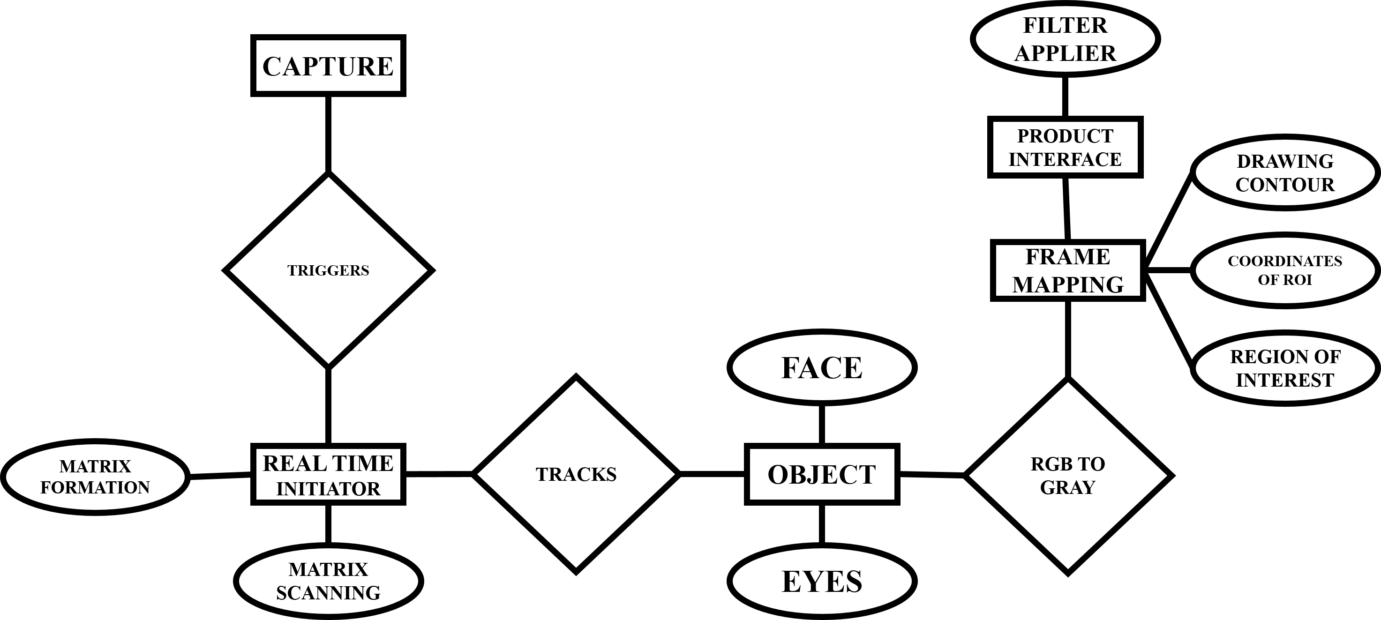
ER DIAGRAM

Slide 6
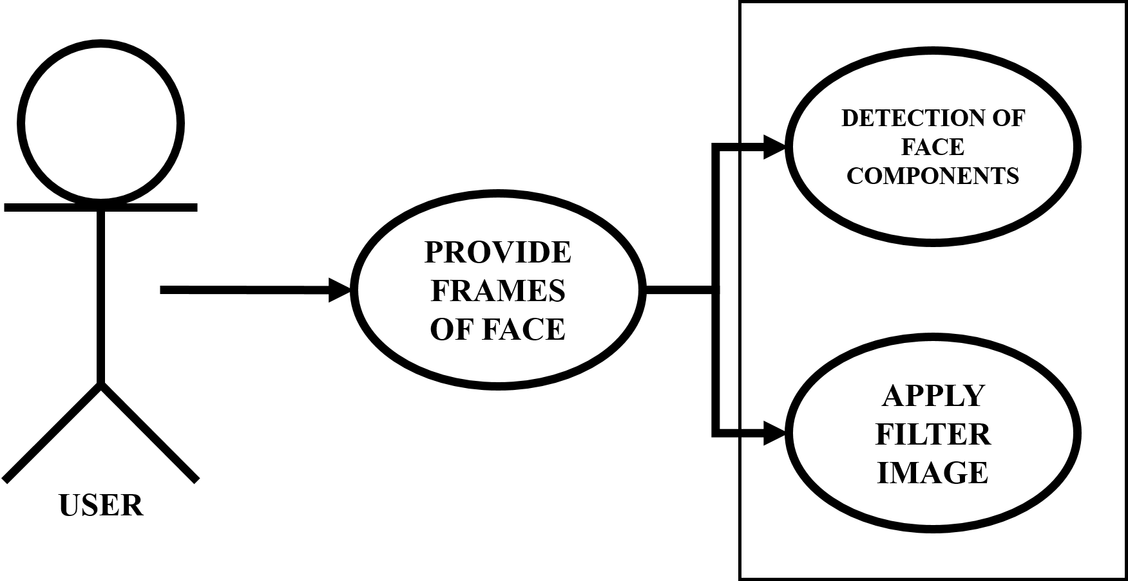
USE-CASE DIAGRAM

Slide 7
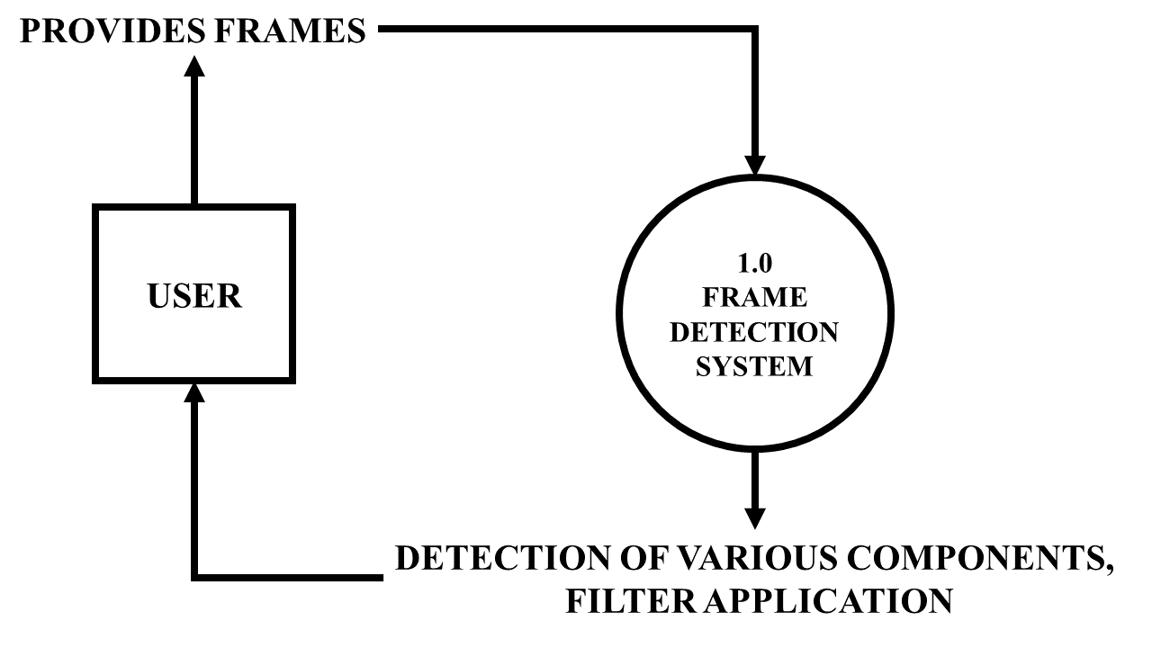
DATA FLOW DIAGRAM
Level 1

Slide 8
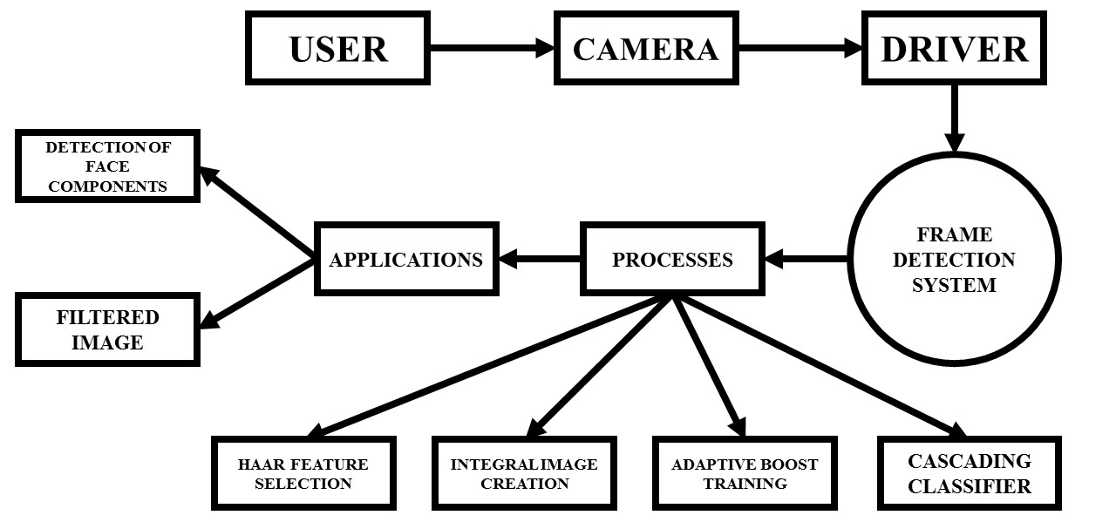
DATA FLOW DIAGRAM
Level 2

Slide 9
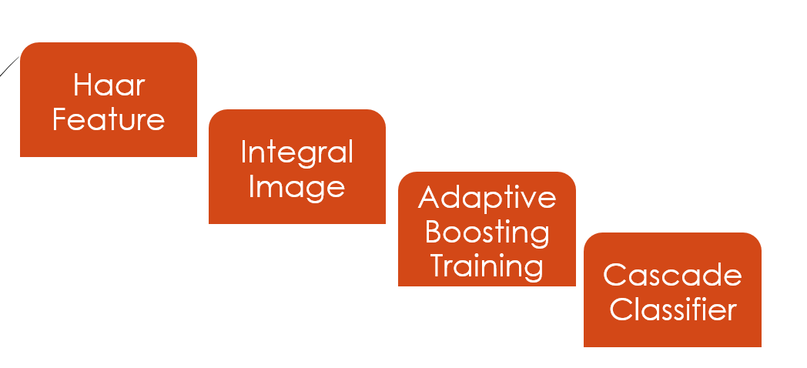
VOILA JONES FACE DETECTOR ALGORITHM

Slide 10
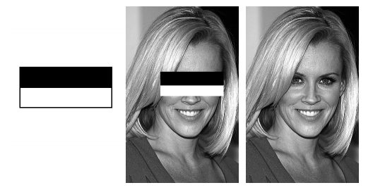
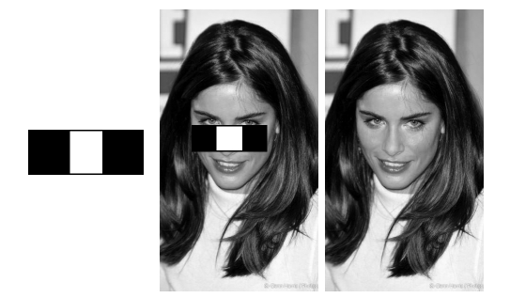
Haar features for Eyes
Haar features are depicted as rectangles of black and white areas
Haar features for Nose

Slide 11
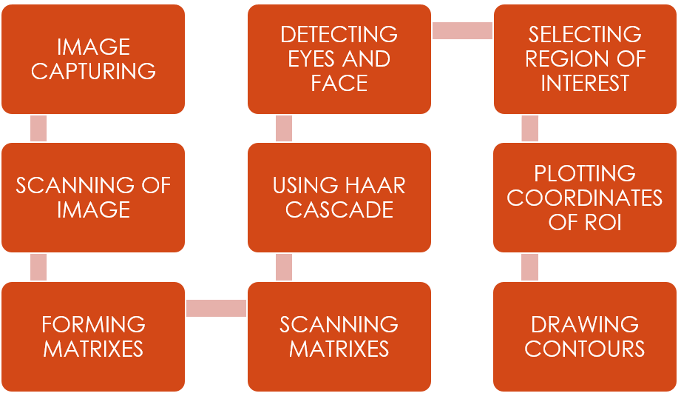
REAL TIME INITIATOR (Phase 1)

Slide 12
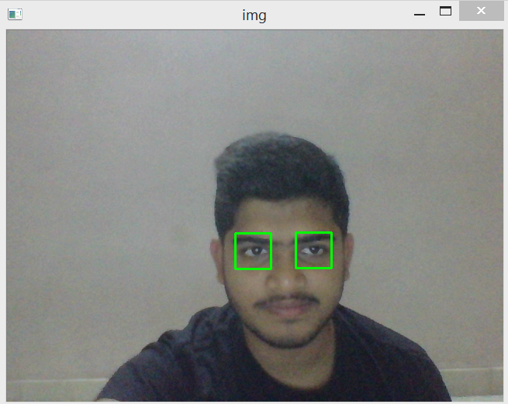
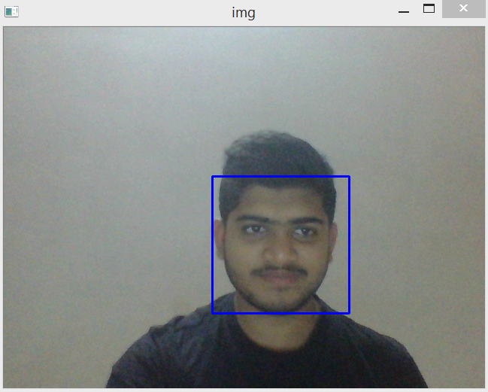
DRAWING CONTOUR AROUND FACE AND EYES

Slide 13
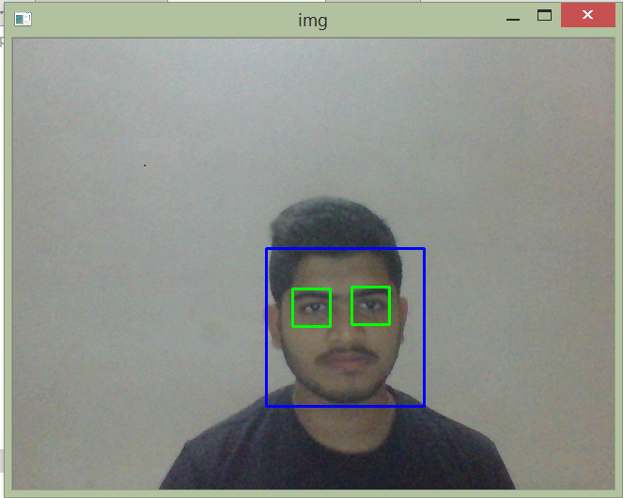
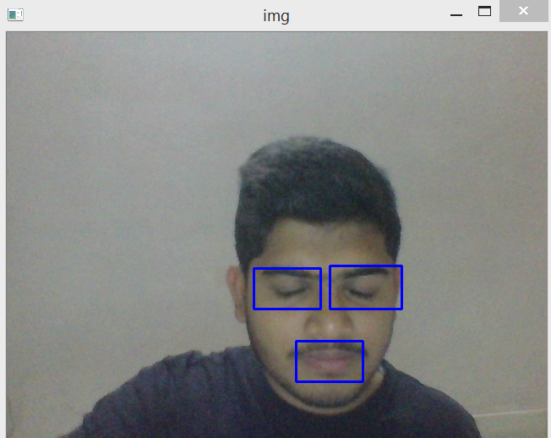
DRAWING CONTOUR AROUND FACE, EYES & MOUTH

Slide 14
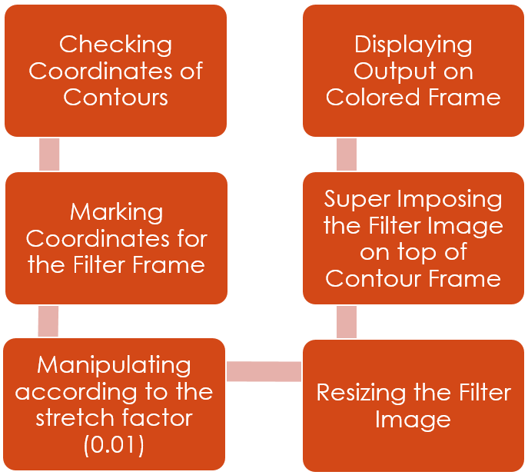
PRODUCT INTERFACE

Slide 15
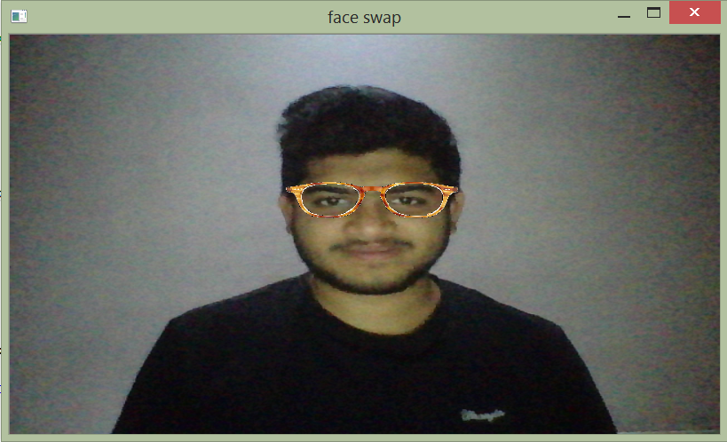
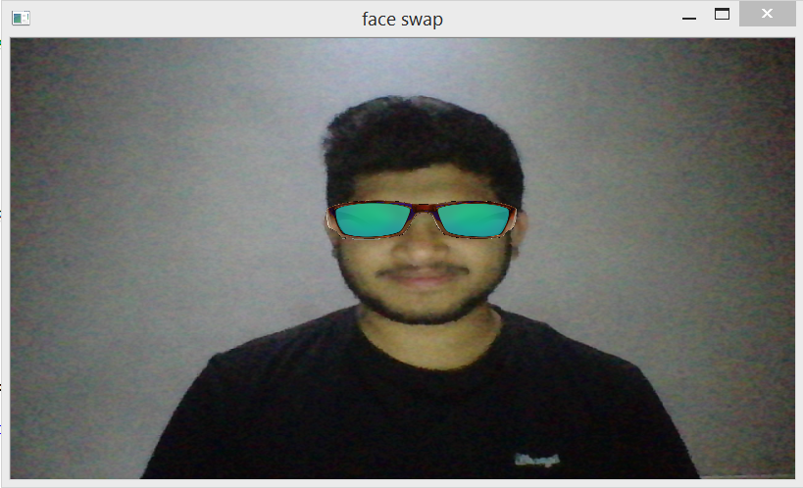
PRODUCT SUPERIMPOSING
(Filter 1 – Eye Glass Frame)

Slide 16
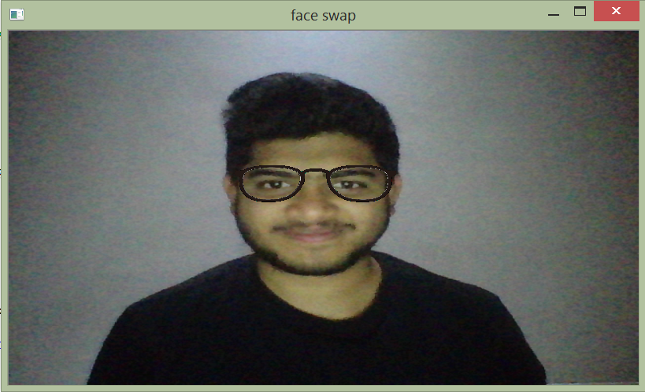
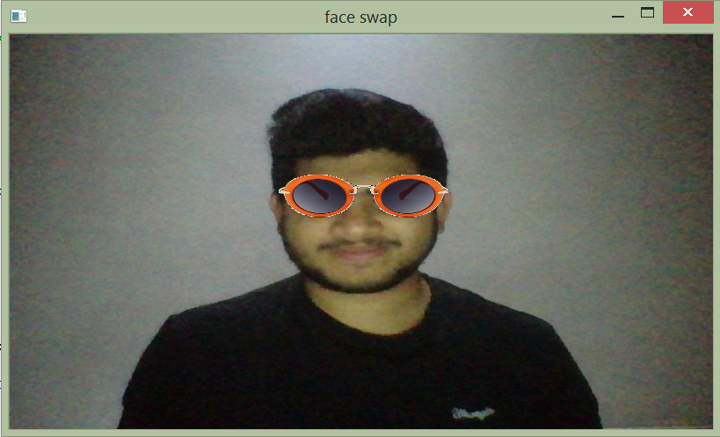
PRODUCT SUPERIMPOSING
(Filter 1 – Eye Glass Frame)

Slide 17
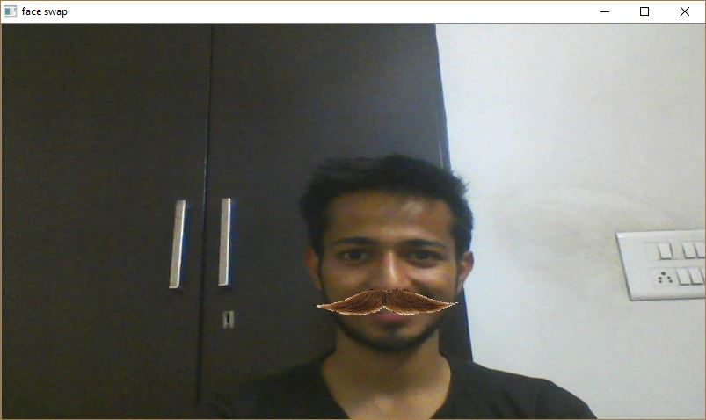
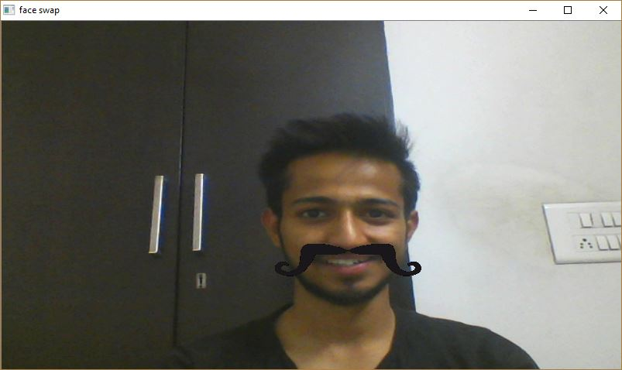
PRODUCT SUPERIMPOSING
(Filter 2 – Moustaches)

Slide 18
APPLICATIONS AND FUTURE SCOPE
It provides a better approach to see how things can look without trying everything physically.
Saves a significant amount of time and avoids product wear and tear.
This application can be used in online shopping E-commerce websites for better approach to view the product.

